Slide 1
End-to-End
Data Analytics Project
Customer Sales Analysis

Slide 2

Project Context: Simulating Real-World Analytics
This project is a personal, industry-style simulation aimed at understanding the end-to-end workflow of a real-world data analytics project.
Goal: Process, analyze, and visualize raw data to generate actionable business insights

Slide 3




Dataset Overview: Customer Sales Data
Source & Format
Primary Focus
Kaggle Customer Sales Data in CSV format.
Analyze customer behavior and sales patterns.
Business Purpose
Identify key business performance trends.

Slide 4




The Analytics Toolkit: Core Technologies
Excel
Python (Pandas)
Initial inspection of raw CSV data.
Data cleaning, preprocessing, and feature engineering.
MySQL
Power BI
Database creation, storage, and SQL analysis.
Interactive dashboard creation and visualization.

Slide 5



Data Preprocessing Pipeline (Python)
Handle Missing Data
Load & Explore
Checked nulls; filled review_rating nulls with median per category.
Loaded CSV using Pandas; used df.info() and df.describe().
Feature Engineering
Standardize & Clean
Created age_group and frequency category columns.
Standardized column names (lowercase, underscores); dropped duplicate column.

Slide 6
Database & SQL Analysis
Database Setup
Installed MySQL and connected to Jupyter.
Created database 'data_analysis'.
Loaded cleaned data into 'sales_data' table.
SQL Querying
Conducted analysis using:
GROUP BY, ORDER BY, WHERE, LIMIT, FROM.
Extracted totals, averages, and category-based trends.

Slide 7
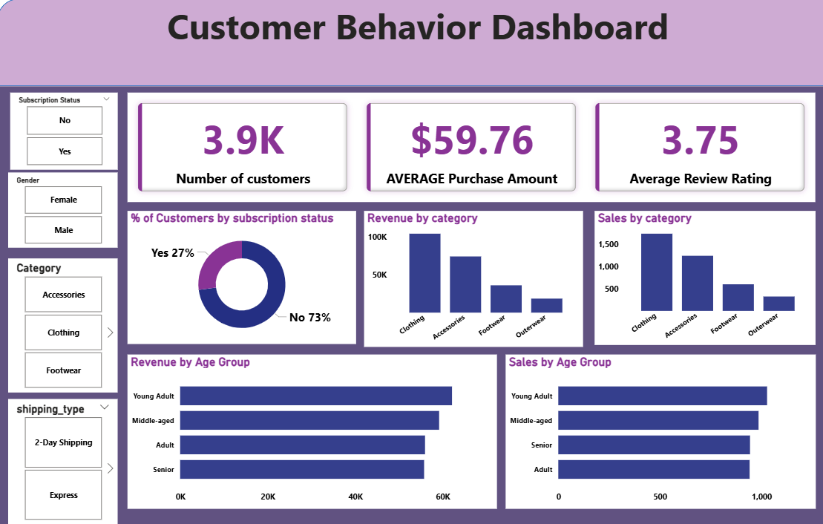
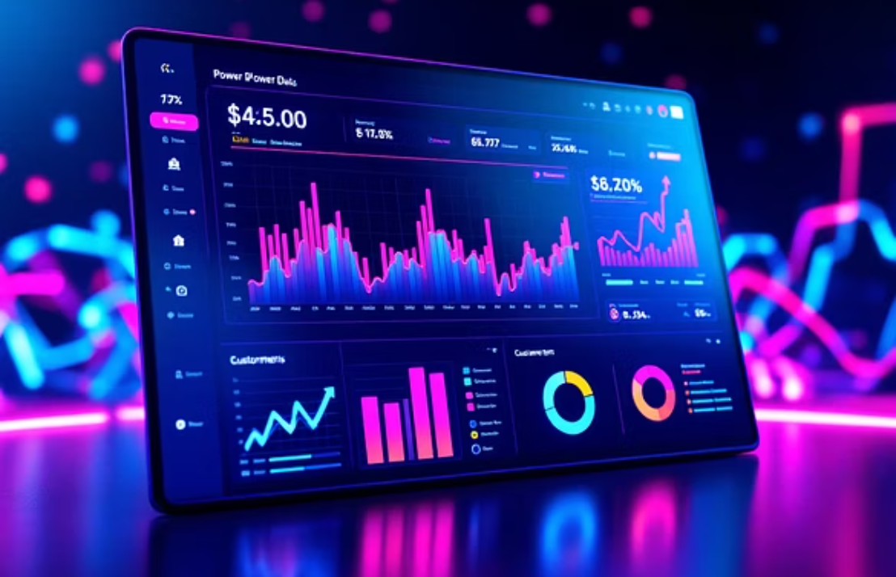

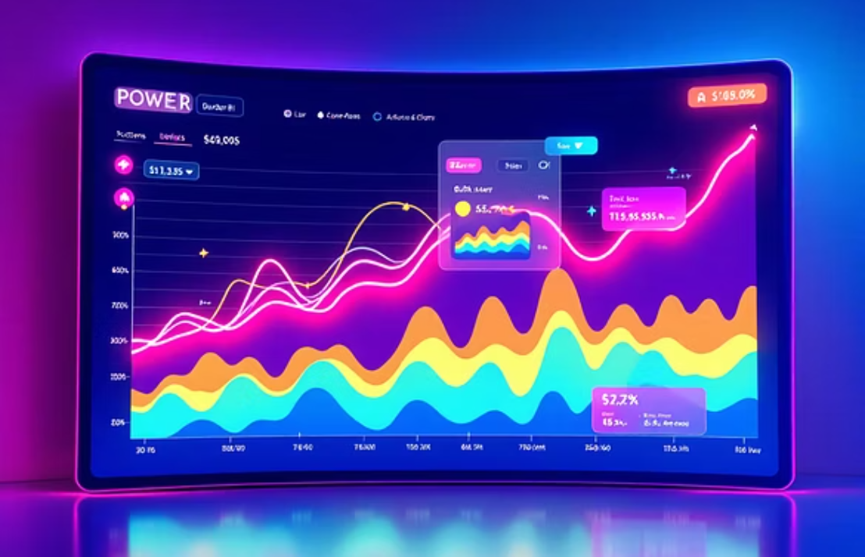
Data Visualization: Power BI Dashboard
The final stage involved translating data insights into visual stories to support data-driven decisions.
Connected MySQL to Power BI to build an interactive dashboard with multi-card visuals, slicers, and charts.

Slide 8
Key Challenges Encountered
Data Quality
Handling null values in significant attributes and removing duplicate columns.
Data Transformation
Mapping numerical data to meaningful categories (e.g., age groups).
Tool Integration
Seamlessly integrating data across Python, MySQL, and Power BI.
Design & Insight
Designing an interactive and genuinely insightful dashboard.

Slide 9




Core Learnings: The Analyst's Takeaway
Preprocessing is Key
Multi-Tool Pipeline
Recognizing the importance of thorough data cleaning and preparation.
Effective use of multiple specialized tools in a cohesive workflow.
SQL Mastery
Visual Communication
Strengthening skills in SQL aggregation and filtering for deep analysis.
Clear communication of complex findings through visualization.

Slide 10
Conclusion: Strengthening the Workflow
This project provided hands-on experience in the complete data analytics workflow, strengthening skills in data cleaning, feature engineering, database management, SQL querying, and visualization, simulating real-world analytics projects. By working with a raw dataset and transforming it into a structured database, I gained practical knowledge of handling missing values, standardizing data, and creating meaningful categorical variables.
The SQL analysis helped reinforce data querying, aggregation, and insight extraction, while connecting the database to Power BI demonstrated how interactive dashboards can communicate key business insights effectively.
Overall, this project emphasized the importance of integrating multiple tools in an end-to-end pipeline, problem-solving when data issues arise, and designing visualizations that support data-driven decision-making. It also provided a realistic perspective of how analytics projects are executed in a business setting, preparing me for future projects with larger datasets and more complex business questions.

